Slide 1
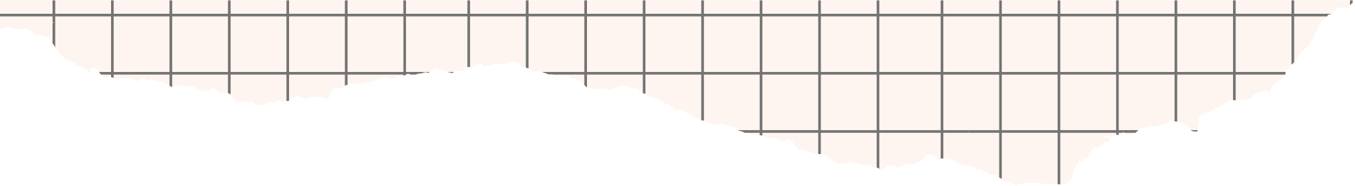



CUSTOMER CHURN
PROJECT
By Jeya Raman Sekar

Slide 2



TODAY'S AGENDA
Introduction
Objective
Problem Statement
Phase – 1
Phase - 2
Phase - 3
Phase - 4
Conclusion

Slide 3







Introduction

Slide 4



INTRODUCTION Customer churn is a critical metric for businesses, especially in the telecom industry. High churn rates can significantly impact a company’s revenue and growth potential. Understanding and analyzing churn helps in developing strategies for customer retention, service improvement, and revenue optimization.
OBJECTIVE
The primary objective is to predict and analyze customer churn in the telecom industry. Utilize data visualization and analysis tools like Power BI, Tableau, and SQL queries. Identify at-risk customers, understand factors contributing to churn, and develop strategies to mitigate churn.
Introduction
&
Objective

Slide 5

Problem

Slide 6




The telecom industry faces high customer churn rates, leading to revenue loss and increased customer acquisition costs..
Need to identify factors leading to churn, analyze customer behavior, and implement targeted retention strategies.
Aim to provide a comprehensive solution for understanding and reducing customer churn through data-driven insights.
Problem
Statement

Slide 7
Phase -1

Slide 8
Data Collection: The process began by understanding the overall data structure and identifying the key areas: customer demographics, service usage, account information, and churn details. Initially, four CSV files were created to organise the data into these categories, ensuring a clear separation of different types of information.
Phase 1 - Data Collection and Preparation

Slide 9
Data Collection: To facilitate a more robust analysis, these CSV files were converted into four tables within an SQL database, representing each aspect of customer data: CustomerDemographics, ServiceInformation, AccountInformation, and ChurnInformation. The data was then imported into the SQL database through the data import wizard, which streamlined the process of bringing in large datasets and setting up the tables for further analysis.
Phase 1 - Data Collection and Preparation

Slide 10
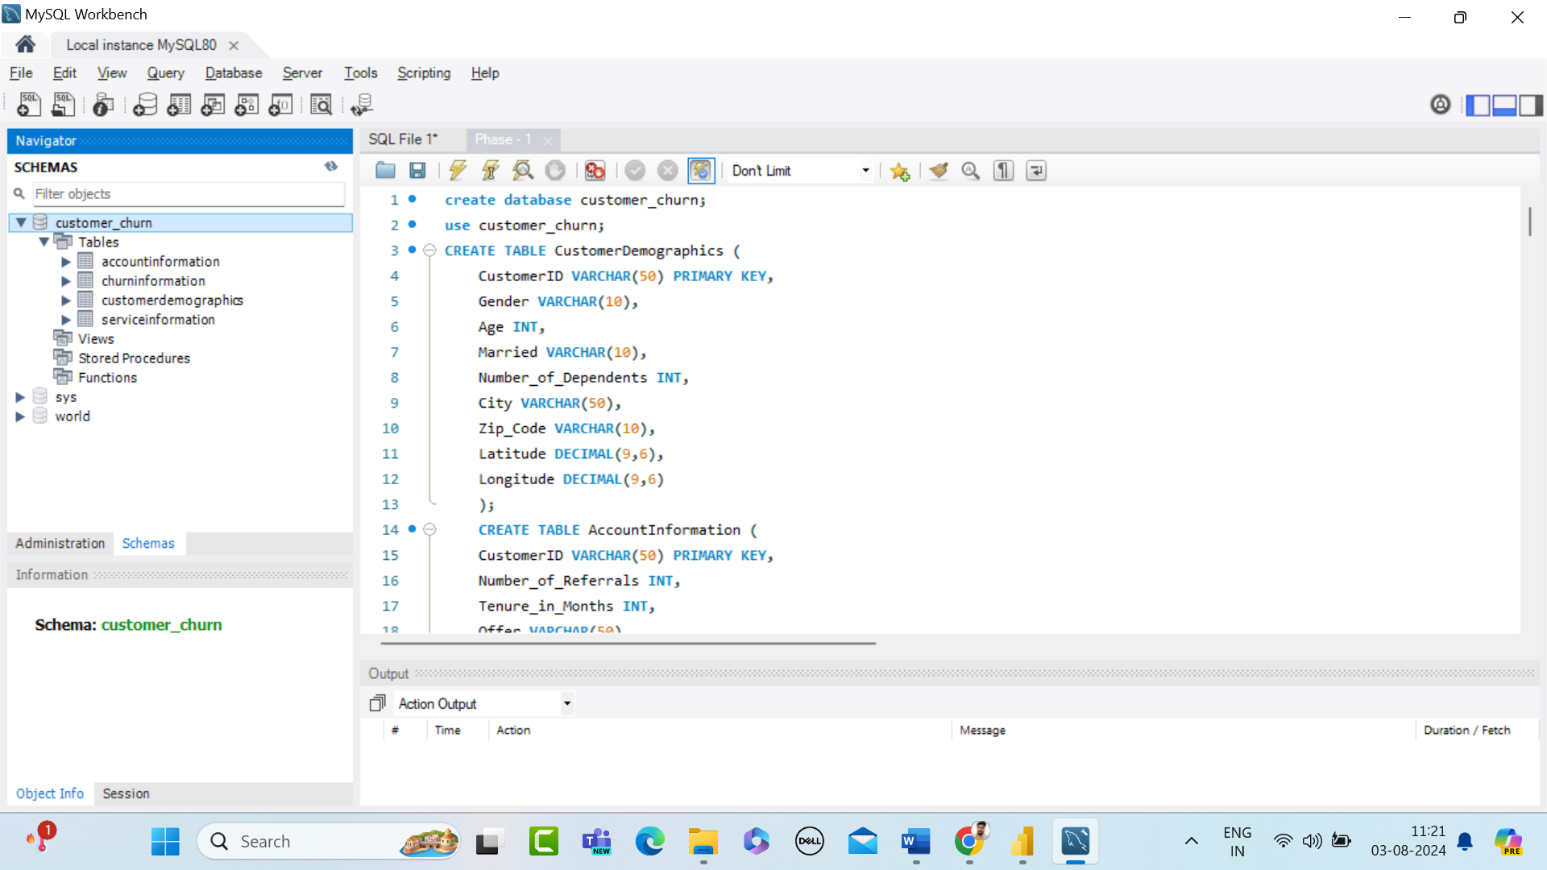
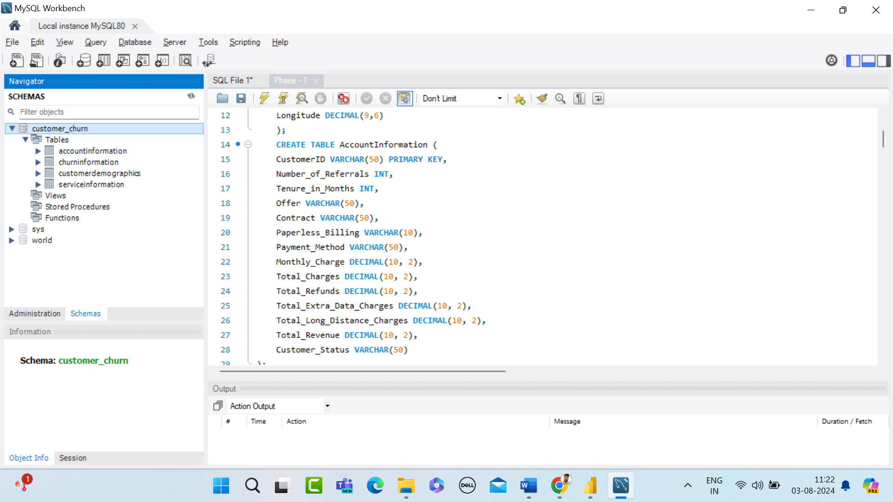
Phase 1 – Schema Creation
Phase 1 – Table Creation

Slide 11
Data Cleaning: Removing Duplicates: Ensured that each customer record was unique by removing any duplicate entries. This step was crucial to maintain the integrity of the analysis, as duplicates could skew results and lead to incorrect conclusions. Handling Missing Values: Missing data can create gaps in analysis. These were addressed by either filling in with relevant values or removing incomplete records, depending on the context and significance of the missing data.
Phase 1 - Data Cleaning

Slide 12
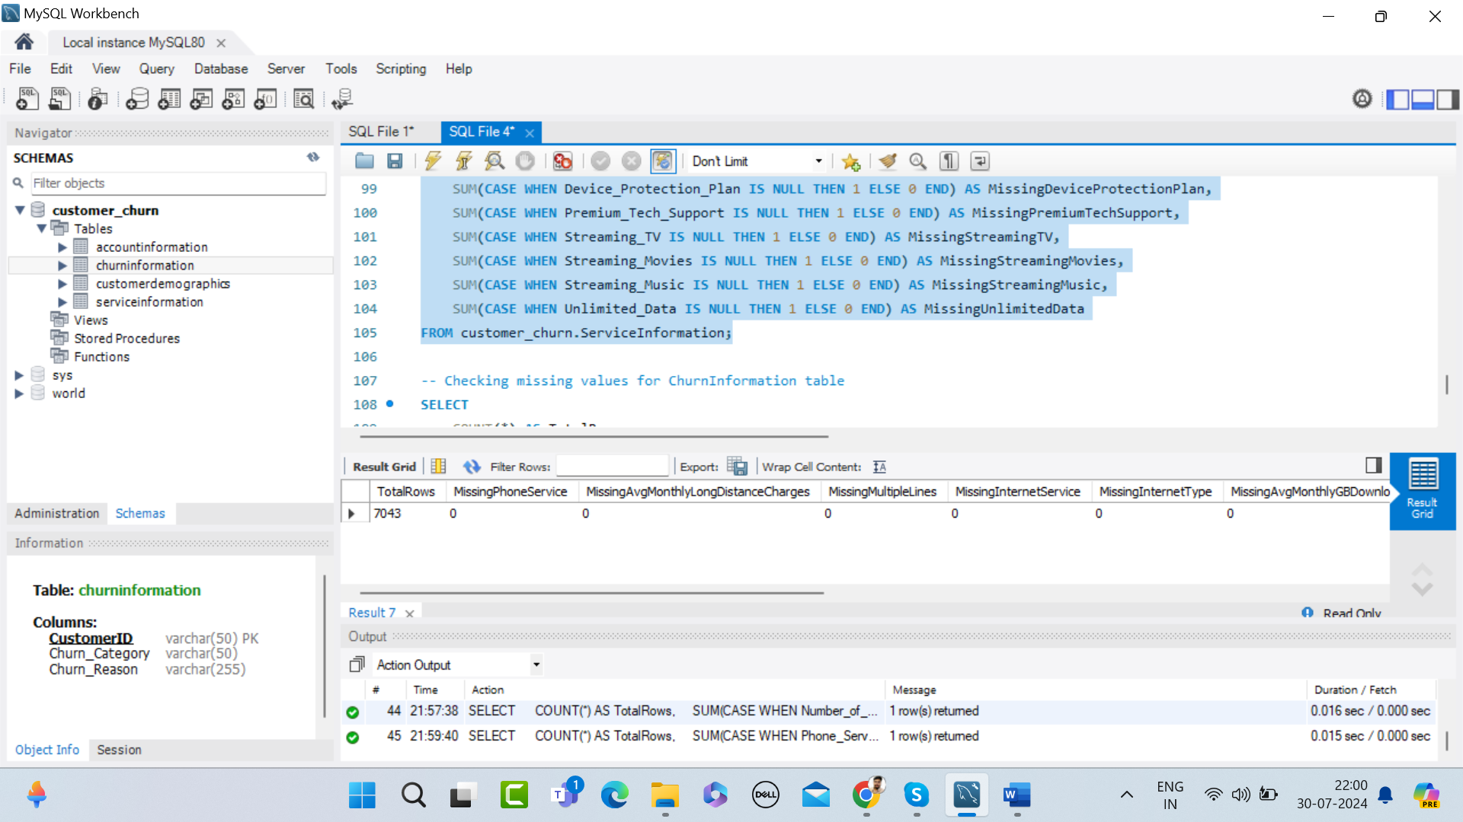
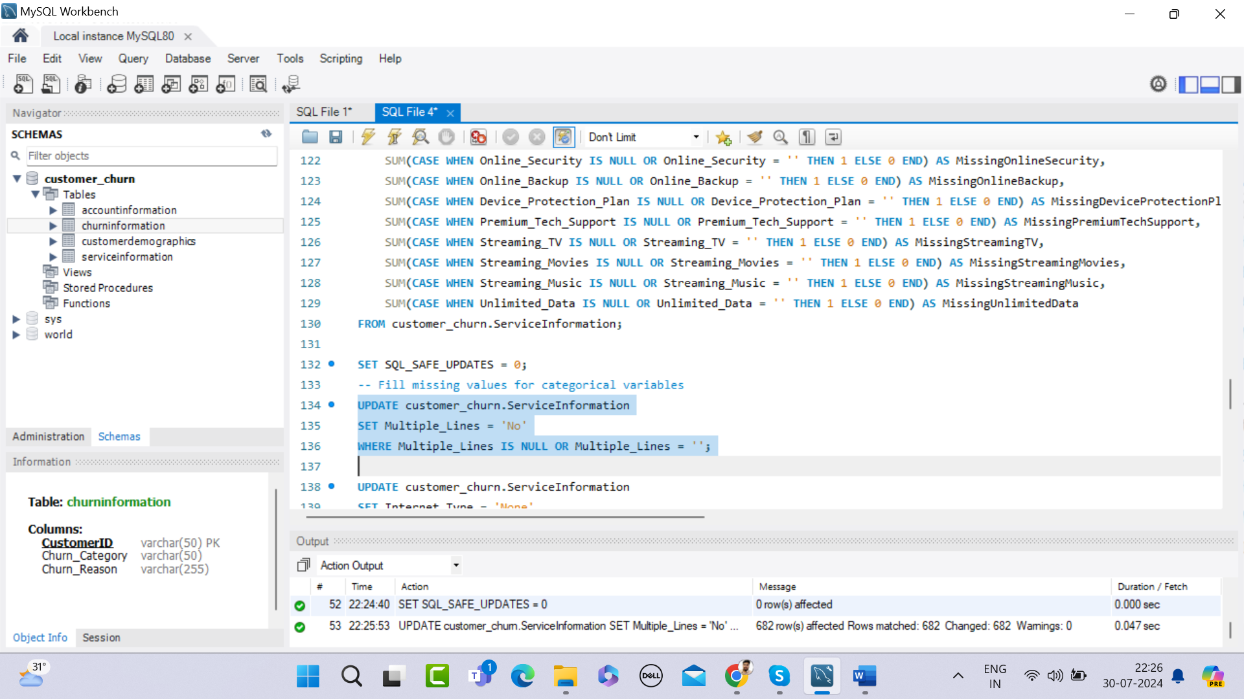
Phase 1 – Identifying Missing Values
Phase 1 – Handling Missing Values

Slide 13
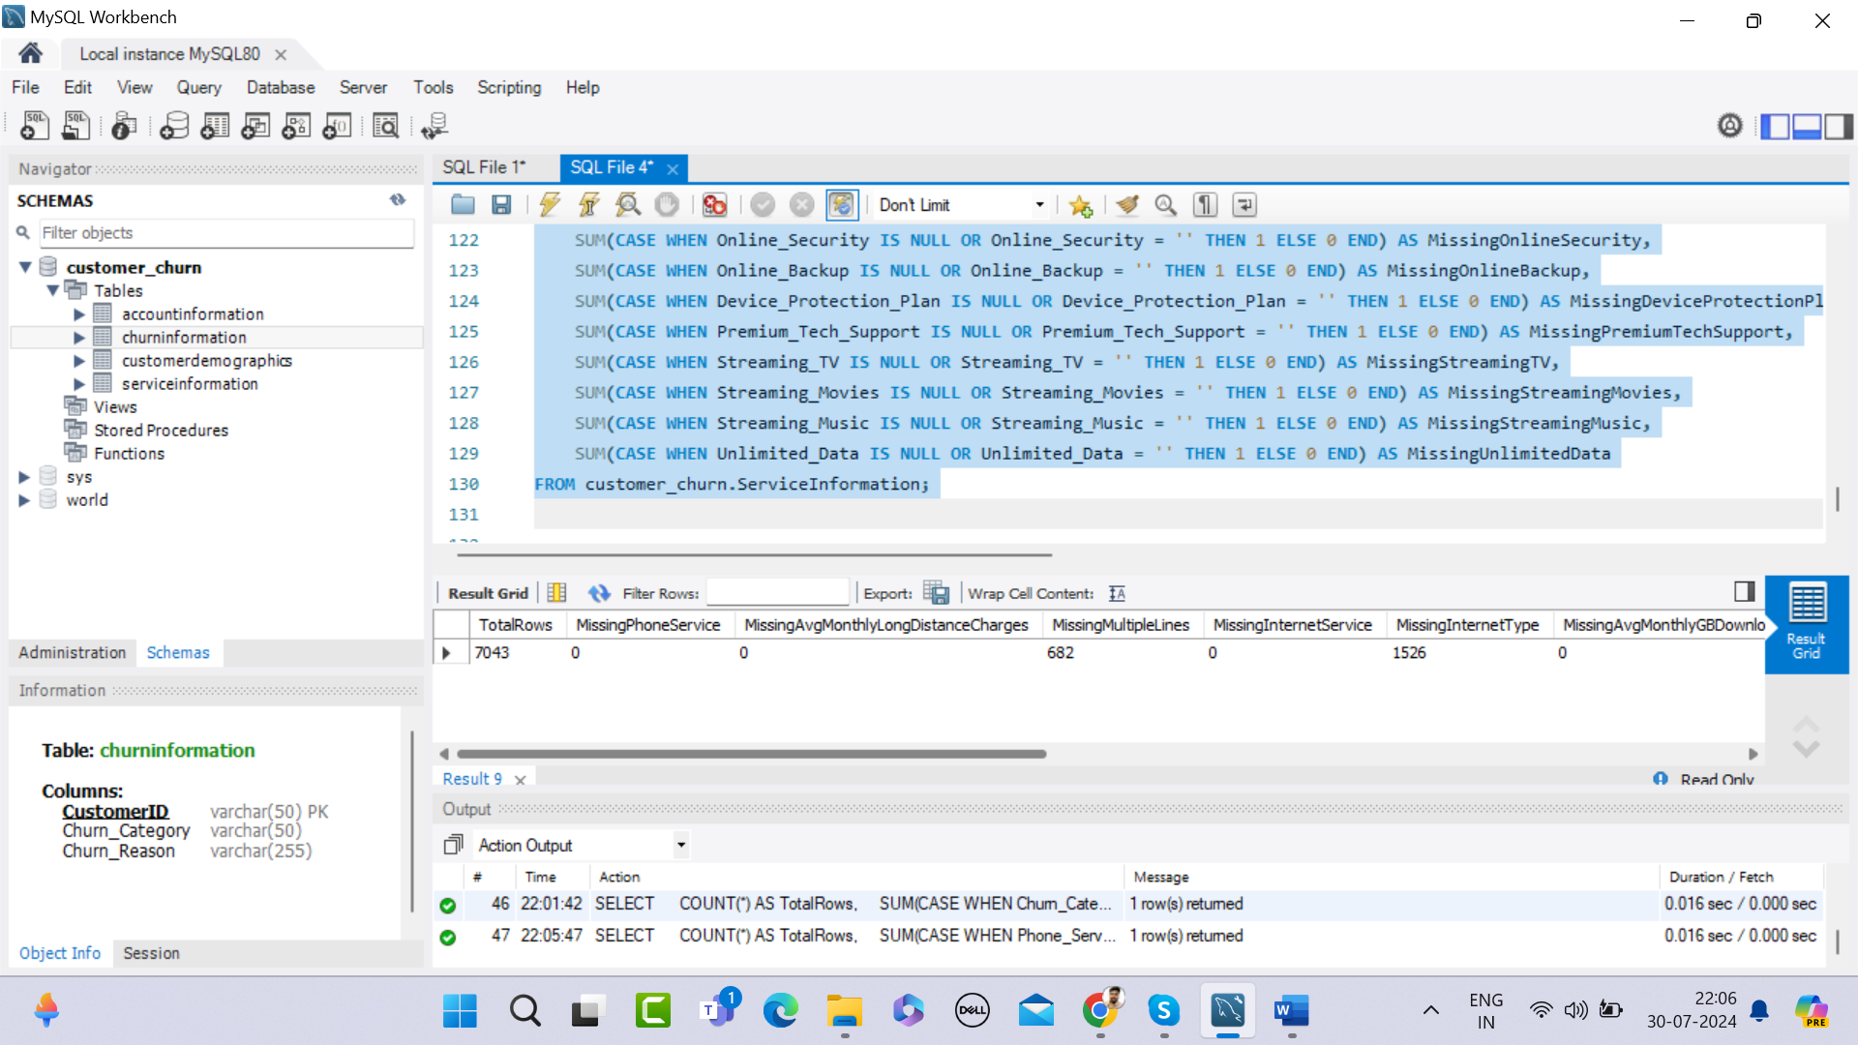
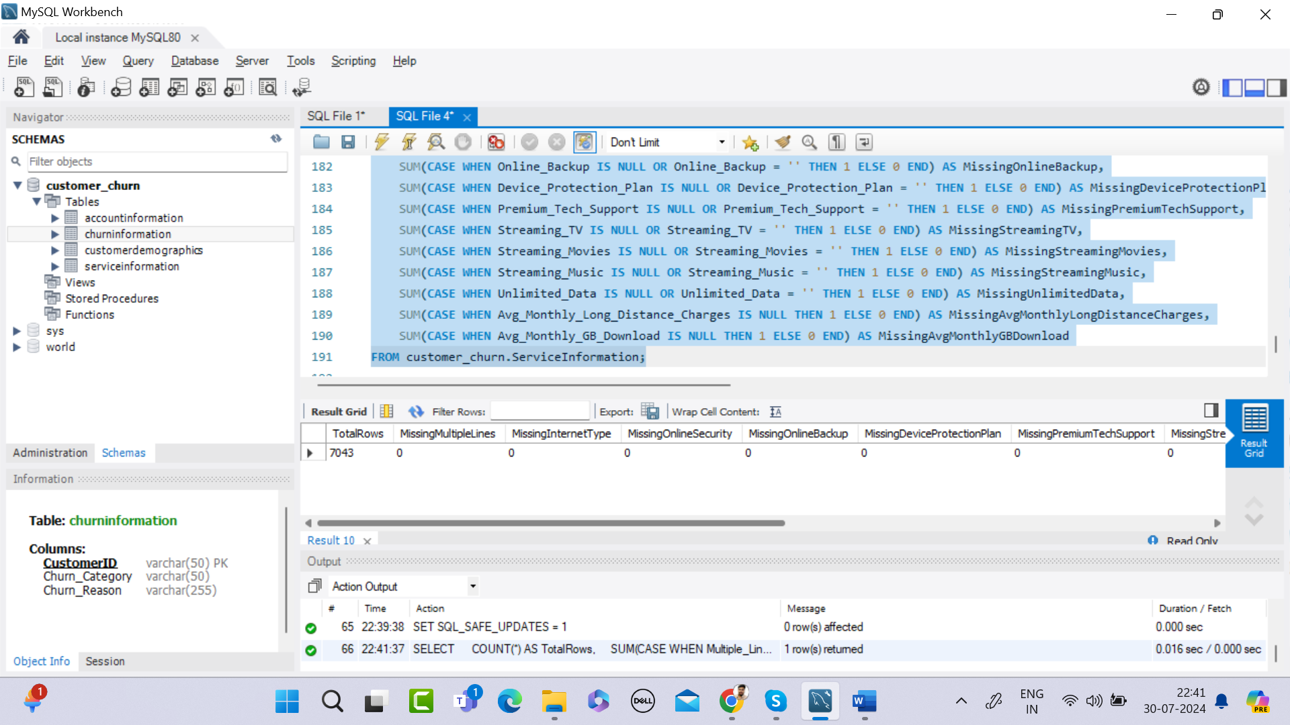
Phase 1 – Missing Values – Service
Information Table
Phase 1 – Missing Values
Rectified

Slide 14
Correcting Inconsistencies: Data inconsistencies, such as variations in naming conventions or data formats, were corrected to ensure uniformity across the dataset. This included standardizing date formats, aligning categorical data, and resolving any discrepancies between related data points.
Phase 1 - Data Cleaning

Slide 15
Data Integration: After cleaning the data, the next step was data integration, where the separate datasets were combined into a unified dataset. This involved merging the data from different sources into a coherent structure, ensuring that all relevant customer information was linked correctly across the different tables.
Phase 1 - Data Integration

Slide 16
Data Integration: Normalization: The data was normalized to eliminate redundancy and improve the efficiency of data retrieval and analysis. This involved organizing the data into tables in such a way that dependencies were maintained, and data integrity was enforced.
Phase 1 - Data Integration

Slide 17
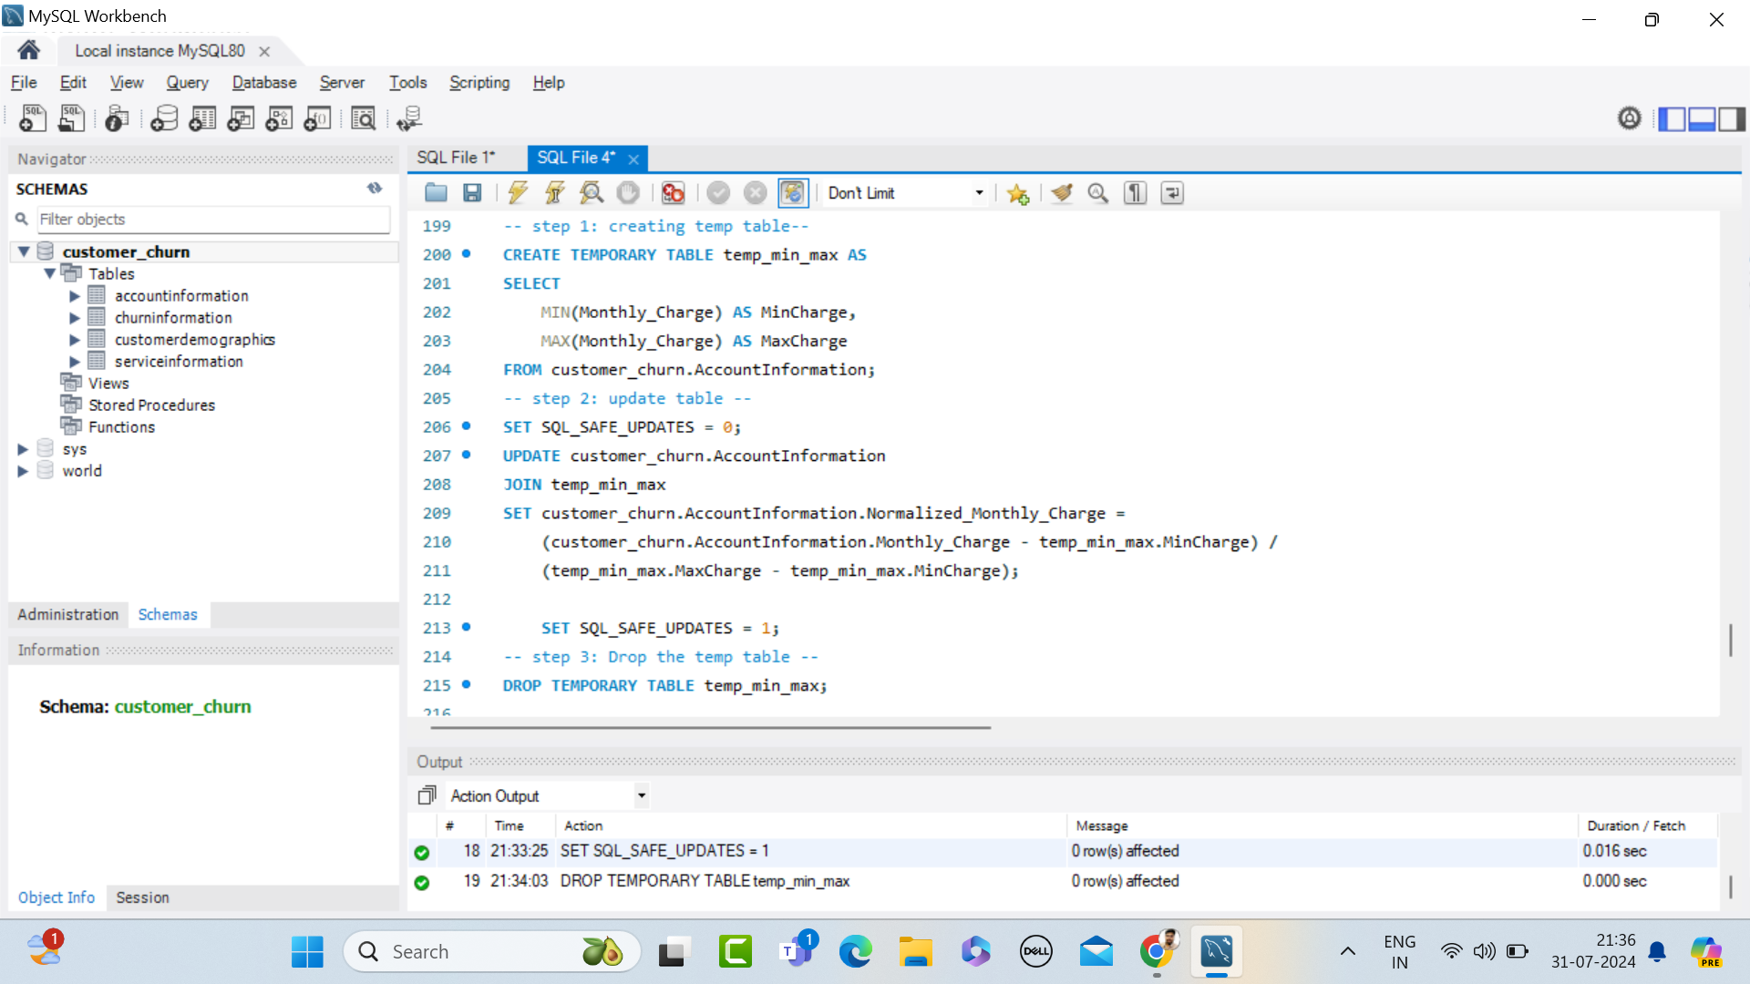
Phase 1 - Normalization

Slide 18
Exploratory Data Analysis (EDA): Summary Statistics: Initial EDA was conducted in Power BI, where summary statistics were generated to understand the central tendencies, dispersion, and distribution of the data. This step helped in identifying the basic structure of the data and any potential outliers or patterns that might require further investigation.
Phase 1 - EDA

Slide 19
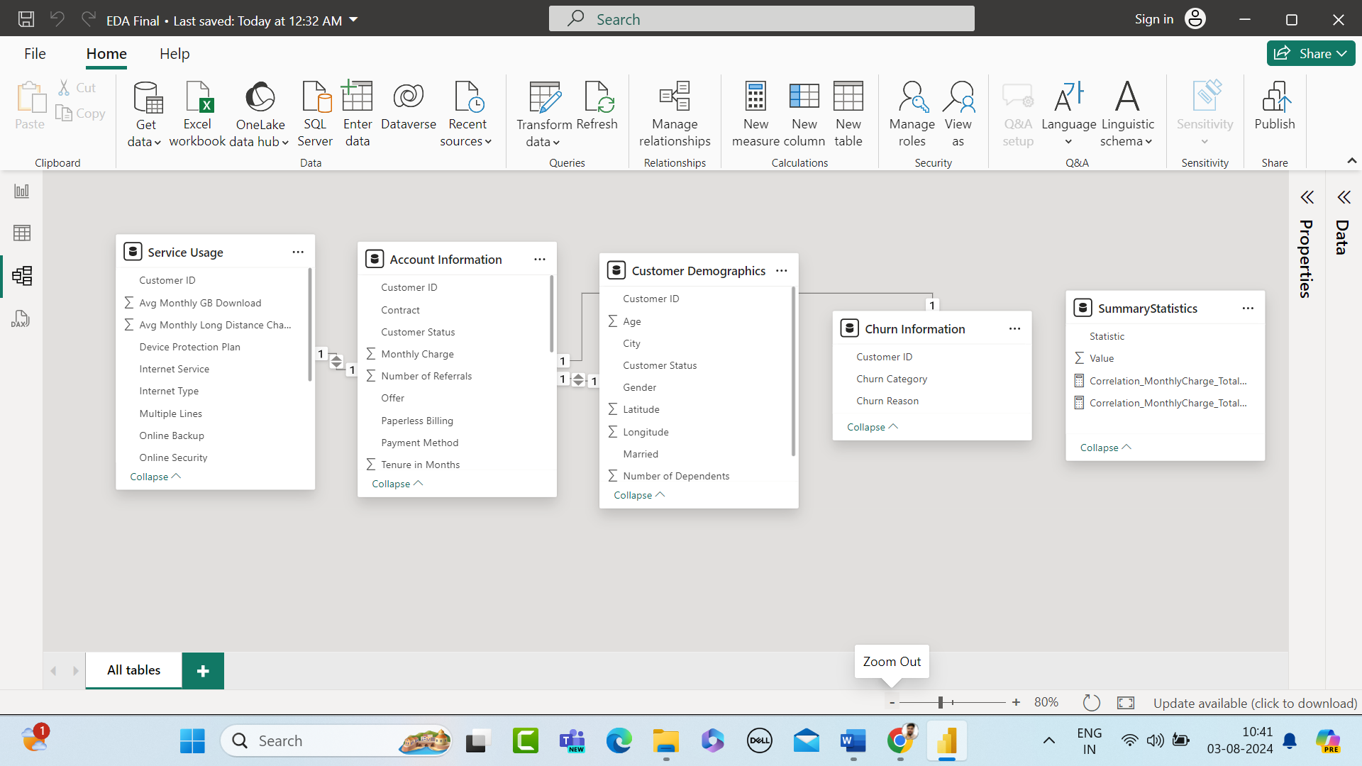
Phase 1 – EDA
Summary Statistics

Slide 20
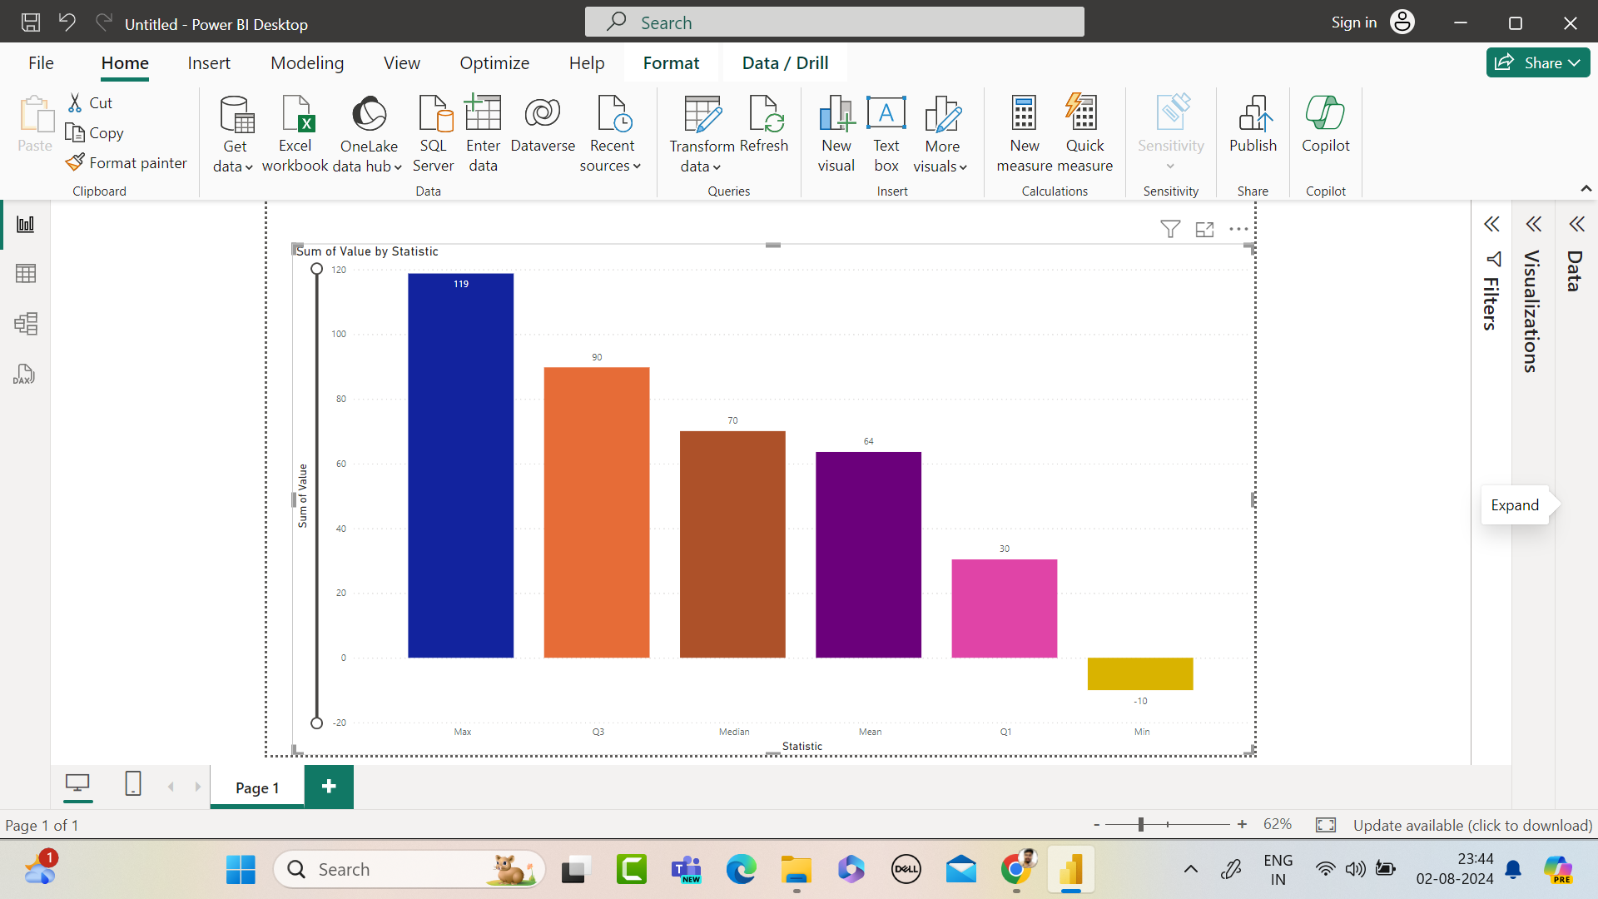
Phase 1 – EDA
Summary Statistics

Slide 21
Exploratory Data Analysis (EDA): Correlation Analysis: Correlation analysis was also performed to identify relationships between different variables. This step was crucial in understanding how different factors might influence customer churn and provided a foundation for the subsequent phases of analysis.
Phase 1 - EDA

Slide 22
Phase - 2

Slide 23
New Measures: Feature engineering involves transforming raw data into meaningful features that help in improving the performance of predictive models. In this phase, new measures were created in Power BI and Tableau to better understand customer churn.
Objectives: The primary goal was to develop metrics and analyses that would provide insights into customer behavior, particularly those who are at risk of churning.
Feature Engineering &
Data Analysis

Slide 24
Measures Taken: Based on Questions Identify the total number of customers and the churn rate Discover the most common contract types among churned customers Create a query to identify the contract types that are most prone to churn Calculate the total charges distribution for churned and non-churned customers Calculate the average monthly charges for different contract types among churned customers
Feature Engineering &
Data Analysis

Slide 25
Measures Taken: Based on Questions Stored Procedure to Calculate Churn Rate Stored Procedure to Identify High-Value Customers at Risk of Churning Identify the gender distribution among customers who have churned and are on yearly contracts Create a view to find the customers with the highest monthly charges in each contract type Find the customers who have churned and are not using online services and their average total charges.
Feature Engineering &
Data Analysis

Slide 26
Measures Taken: Based on Questions Find the average age of churned customers Analyze the distribution of monthly charges among churned customers Identify customers with high total charges who have churned
Feature Engineering &
Data Analysis

Slide 27
1. Identify the total number of customers and the churn rate Total Customer Calculation: Total Customers = COUNT('CustomerDemographics'[Customer ID]) Total Churned Customers Calculation: TotalChurnedCustomers = CALCULATE(COUNT('AccountInformation'[Customer ID]), 'Account Information'[Customer Status] = "Churned"
Total Customers &
Churn Rate

Slide 28
1. Identify the total number of customers and the churn rate Churn Rate Calculation: ChurnRate = DIVIDE([TotalChurnedCustomers], [Total Customers]) * 100
Total Customers &
Churn Rate

Slide 29
Explanation: The Total Customers measure counts the total number of rows in the Customer Demographics table. The TotalChurnedCustomers measure calculates the number of customers with a status of "Churned" in the Account Information table. The Churn Rate measure calculates the percentage of churned customers by dividing the number of churned customers by the total number of customers and multiplying by 100 to get the percentage.
Total Customers &
Churn Rate

Slide 30
Churned Customers by Contract Type: ChurnedCustomersByContractType = CALCULATE(COUNTROWS('Account Information'), 'Customer Demographics'[Customer Status] = "Churned") Churn Rate Calculation: ChurnRate = DIVIDE([TotalChurnedCustomers], [Total Customers]) * 100
Common Contract
Type – Churned Customers

Slide 31
Explanation: The Churned Customers by Contract Type measure calculates the number of churned customers for each contract type. The Churn Rate measure calculates the percentage of churned customers by dividing the number of churned customers by the total number of customers and multiplying by 100 to get the percentage.
Common Contract
Type – Churned Customers

Slide 32
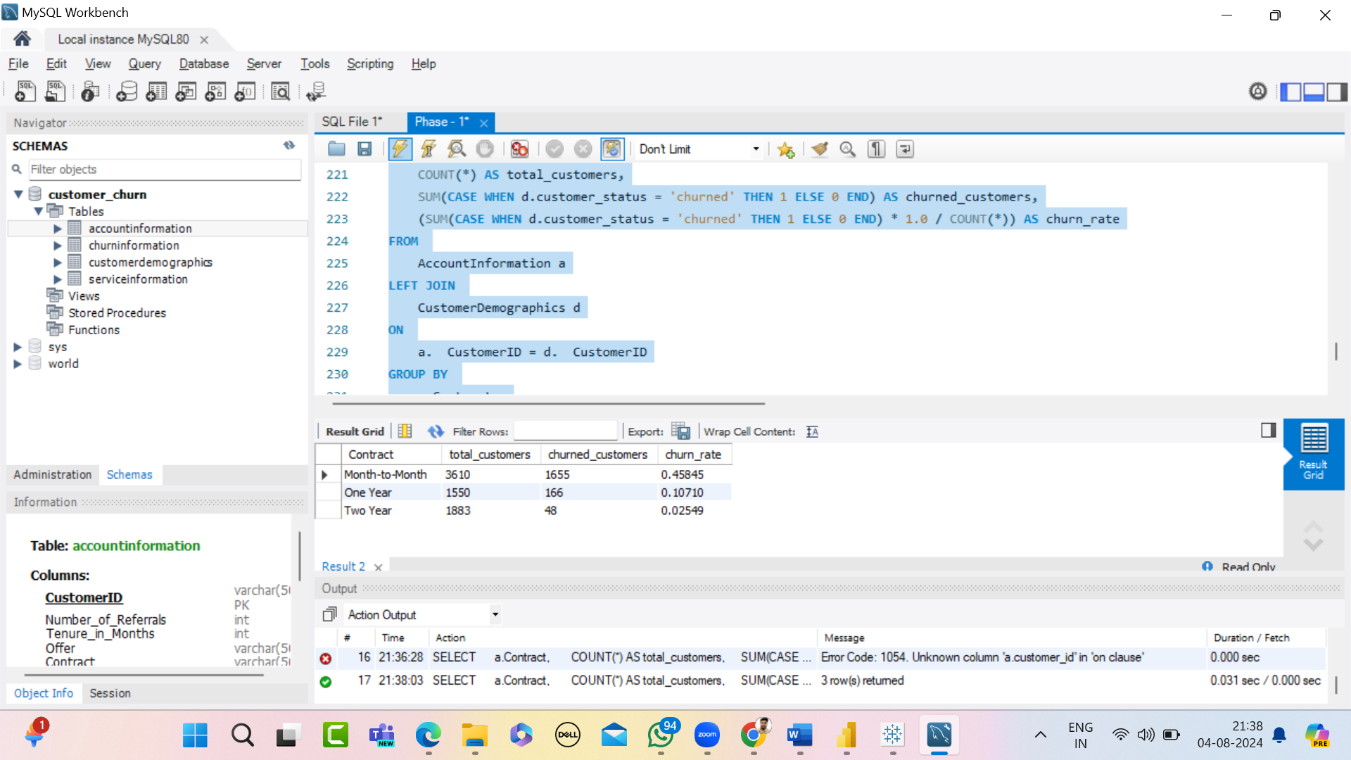
SQL Query – To IdentifyContract Types to churn

Slide 33
Explanation: By running this query, you will get a list of contract types along with the total number of customers, the number of churned customers, and the churn rate for each contract type, sorted by the churn rate in descending order.
SQL Query – To Identify
Contract Type to Churn

Slide 34
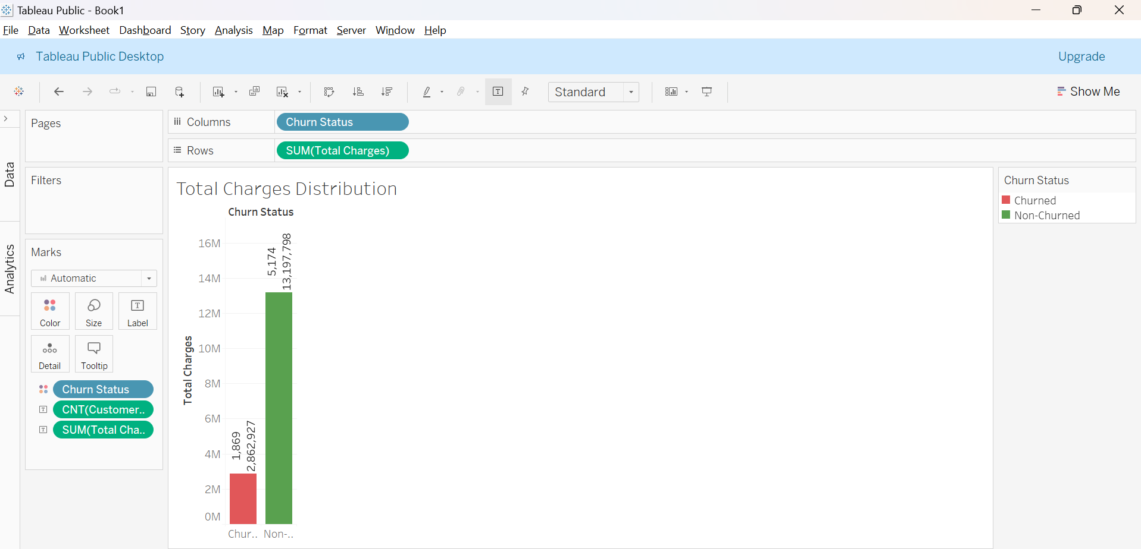
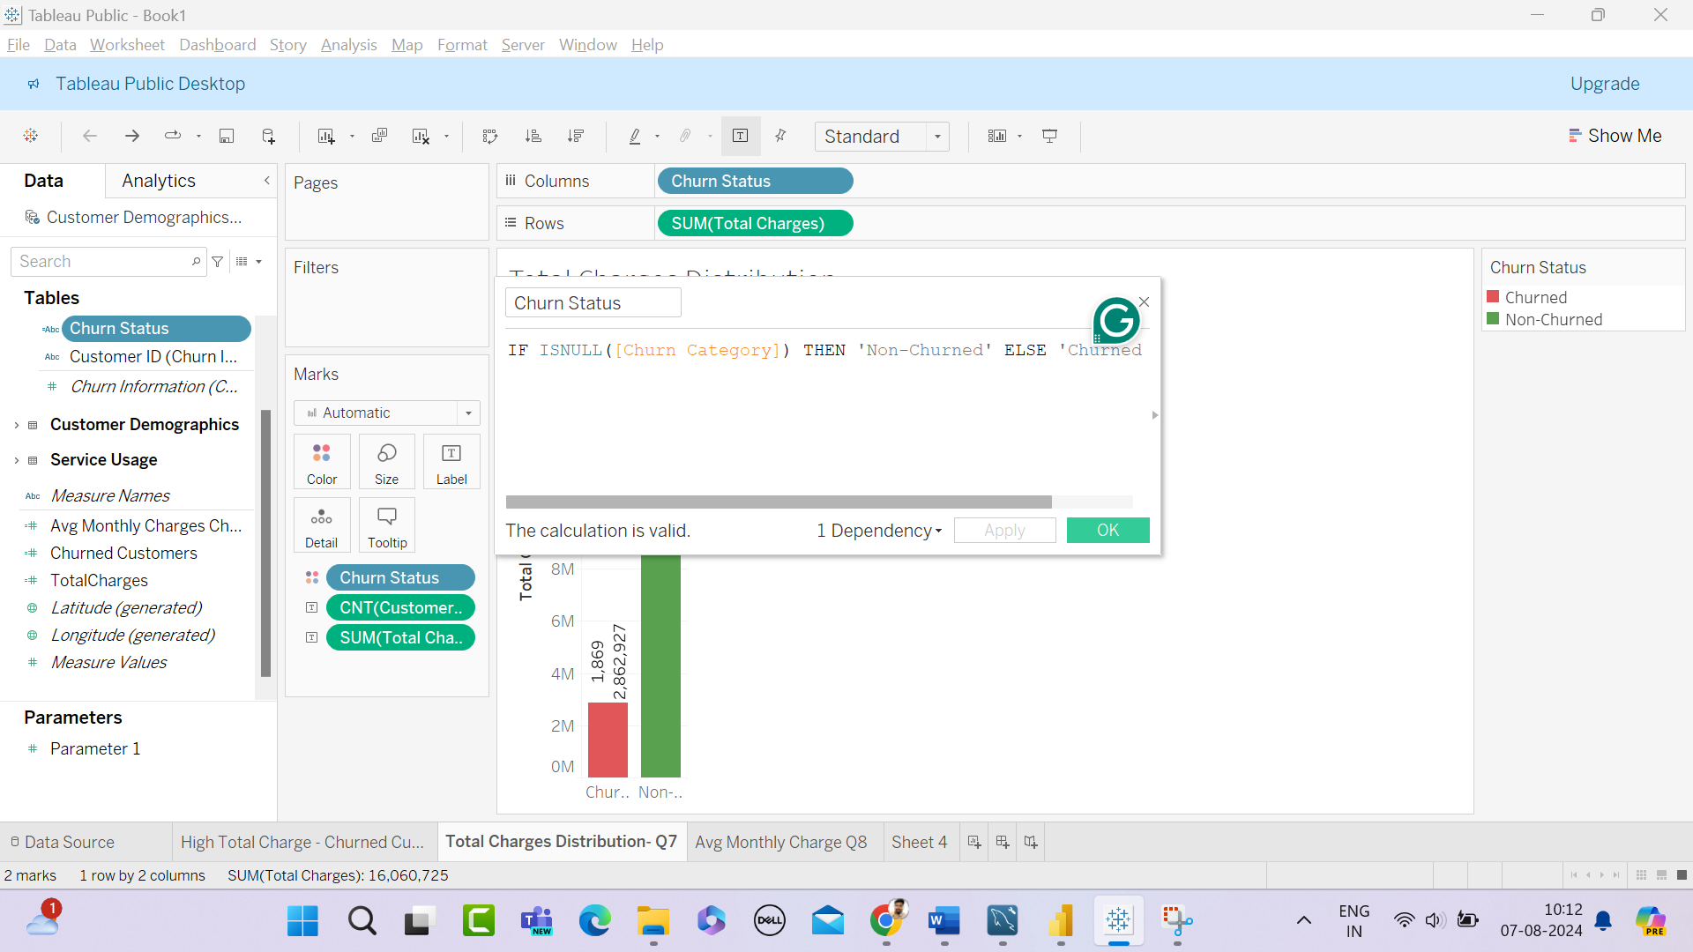
The calculated field Churn Status distinguishes between churned and non-churned customers.
Total Charges Distribution for Churned & Non-churned Customers

Slide 35
Avg Monthly Charges for Different Contract Types
Among Churned Customers
Average Monthly Charges Churned:
AvgMonthlyChargesChurned = CALCULATE(AVERAGE('Account Information'[Monthly Charge]), 'Account Information'[Customer Status] = "Churned")
Churned Customers by Contract Type:
ChurnedCustomersByContractType = CALCULATE(COUNTROWS ('Account Information'),
'Customer Demographics'[Customer Status] = "Churned")

Slide 36
Avg Monthly Charges for Different Contract Types
Among Churned Customers
Explanation:
The average monthly Charges Churned measure calculates the average monthly charges for churned customers.
The average monthly Charges Churned by Contract Type measure calculates the average monthly charges for churned customers grouped by contract type.

Slide 37
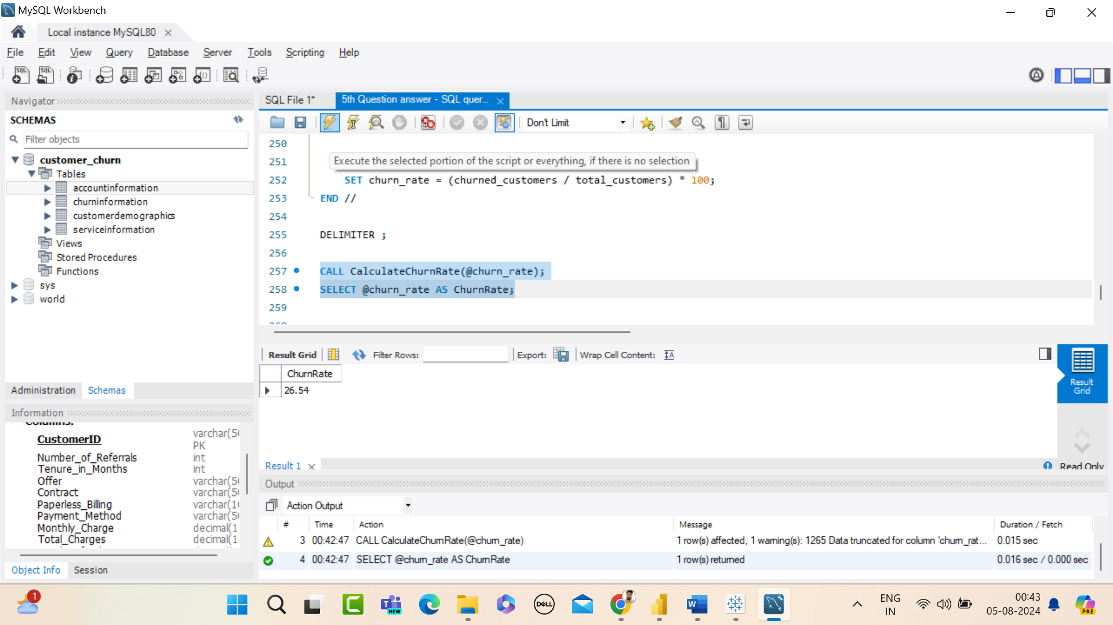
Stored Procedure – Churn Rate
Explanation:
From this store procedure churn rate is calculated.
26.54 = churn rate

Slide 38
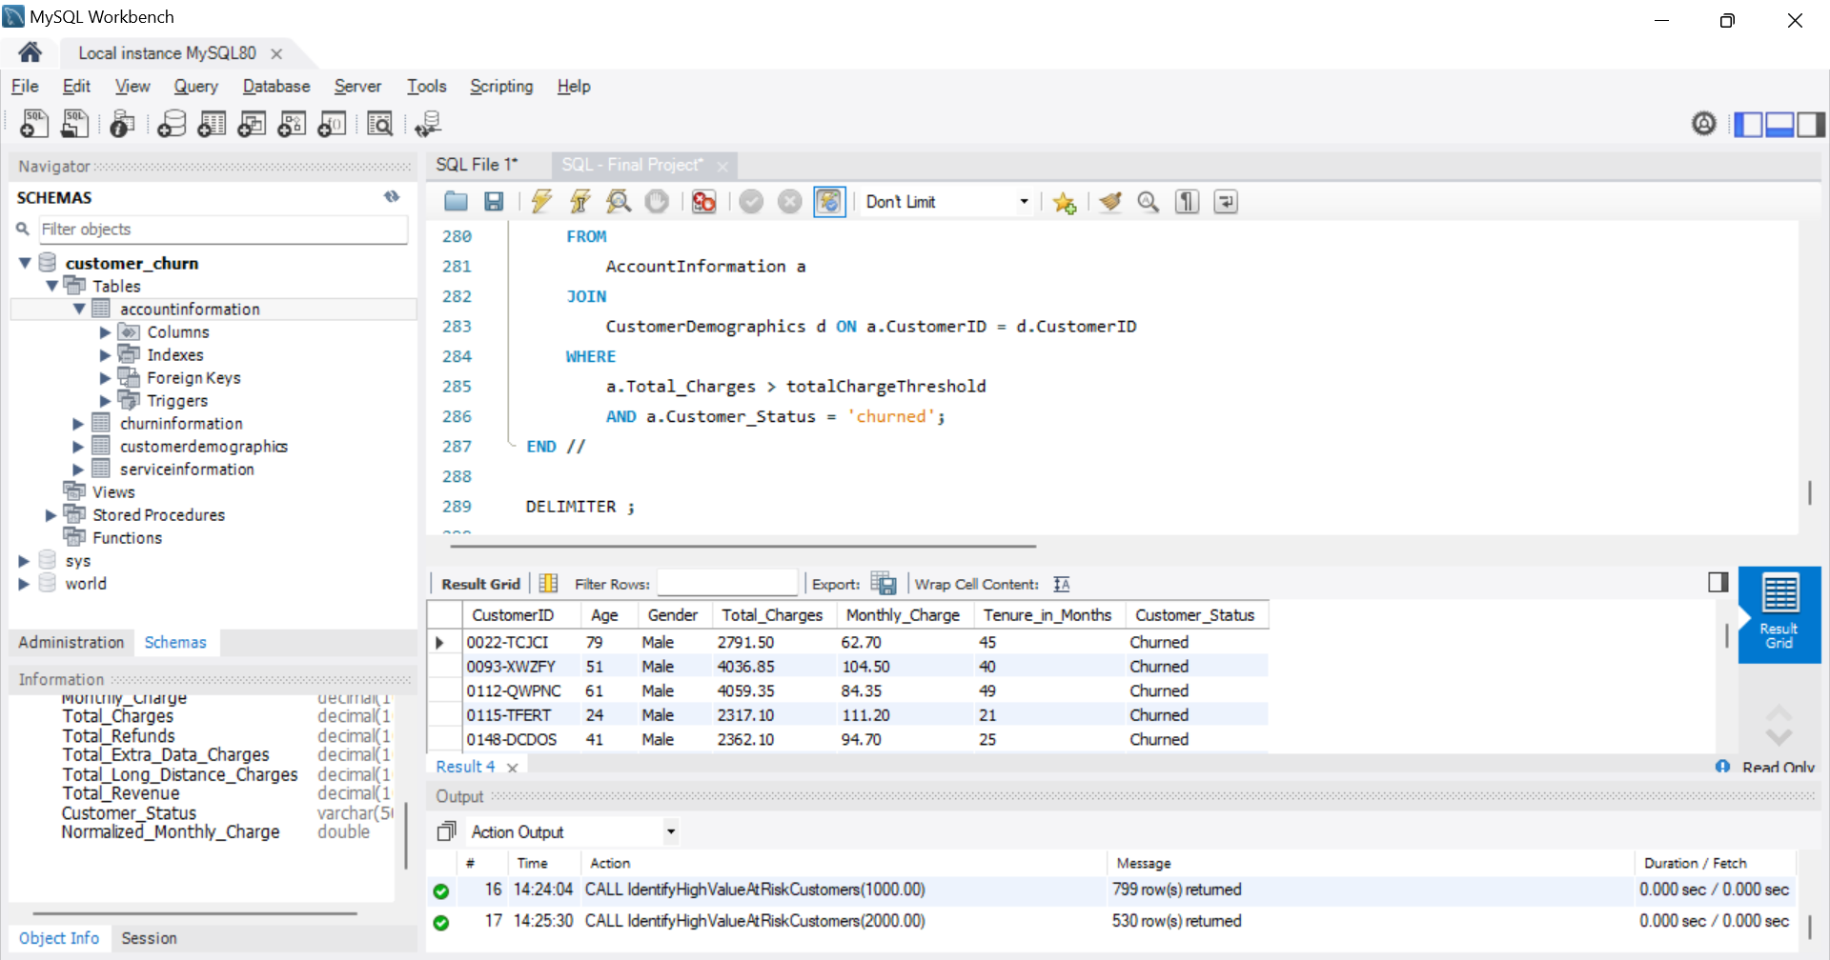
Stored Procedure – To Identify High-Value Customers
at Risk of Churning
Explanation:
CALL IdentifyHighValueAtRiskCustomers(3000.00);
This call will now filter customers with total charges above 3000.00 and who have churned. You do not need to modify the stored procedure itself; just adjust the parameter value when calling it.

Slide 39
Identify Gender Distribution – Churned Customers – Yearly Contracts
Explanation:
Filter Churned Customers on Yearly Contracts:
The use of filters, customizations, and labels ensures that the visualization is focused, clear, and informative, aiding in effective data analysis and decision-making.

Slide 40
Customers With the Highest Monthly Charge – Each Contracts
Explanation:
For this question, - I used contract type, monthly charge, customer ID for the count, and For more visual appeal used card and slice

Slide 41
Churned Customers – Not Using Online Service & Their Avg Total Charges
Explanation:
For this question, I used the filter – customer status “churned” and Internet service “No”
Avg total charges of churned customers measure found. For more clarity added gender wise classification in the label.

Slide 42
Find the Average Age of Churned Customers
AvgAgeChurnedCustomers = CALCULATE(AVERAGE('Customer Demographics'[Age]), 'Account Information'[Customer Status] = "Churned")
Explanation:
This measure calculates the average age for customers whose status is "Churned".

Slide 43
Analyze the Distribution of Monthly Charges Among Churned Customers
Monthly Charge field to create bins. – created bin group
Filter for Churned Customers:
Apply a filter to include only churned customers.
Explanation: Filtering ensures the analysis is specific to churned customers.

Slide 44
Phase - 3

Slide 45
Data Visualization
&
Dashboard Creation

Slide 46
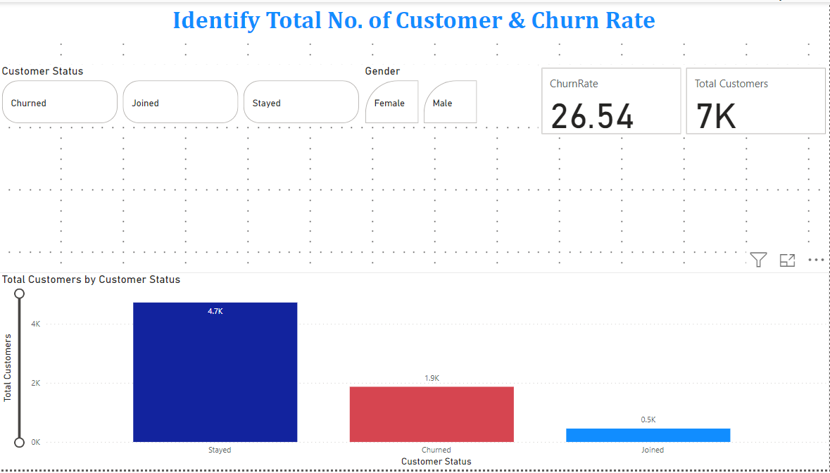
Identify Total Customers &
Churn Rate

Slide 47
Identify Total Customers and Churn Rate
From this visual, we can understand the total no. of customers, churn rate.
X-axis Customer status
Y-axis Total Customers
Added cards, and slicers for a more appealing visual

Slide 48
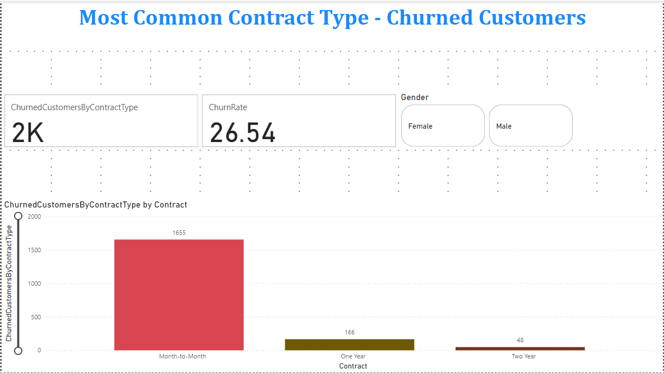
Most Common Contract Types – Churned Customers

Slide 49
Common Contract Types - Churned Customers
X-axis Contract
Y-axis Churned Customers by Contract Type
For better clarity, added a card visual and a slice visual.

Slide 50
SQL Visualization
Query to Identify the Contract Type – Prone to Churn

Slide 51
SQL Query to Identify Contract Type – Prone to Churn
This query provides a list of contract types along with the total number of customers, the number of churned customers, and the churn rate for each contract type, sorted by the churn rate in descending order.

Slide 52
Tableau Visualization
Total Charges Distribution – Churned &
Non – Churned Customers

Slide 53
Total Charges Distribution – Churned & Non–Churned Customers
Created a field to distinguish between churned and non-churned customers.
From the bar visual, total charges distribution for both churned and non-churned customers.
X-axis Churn Status
Y-axis Total Charges

Slide 54
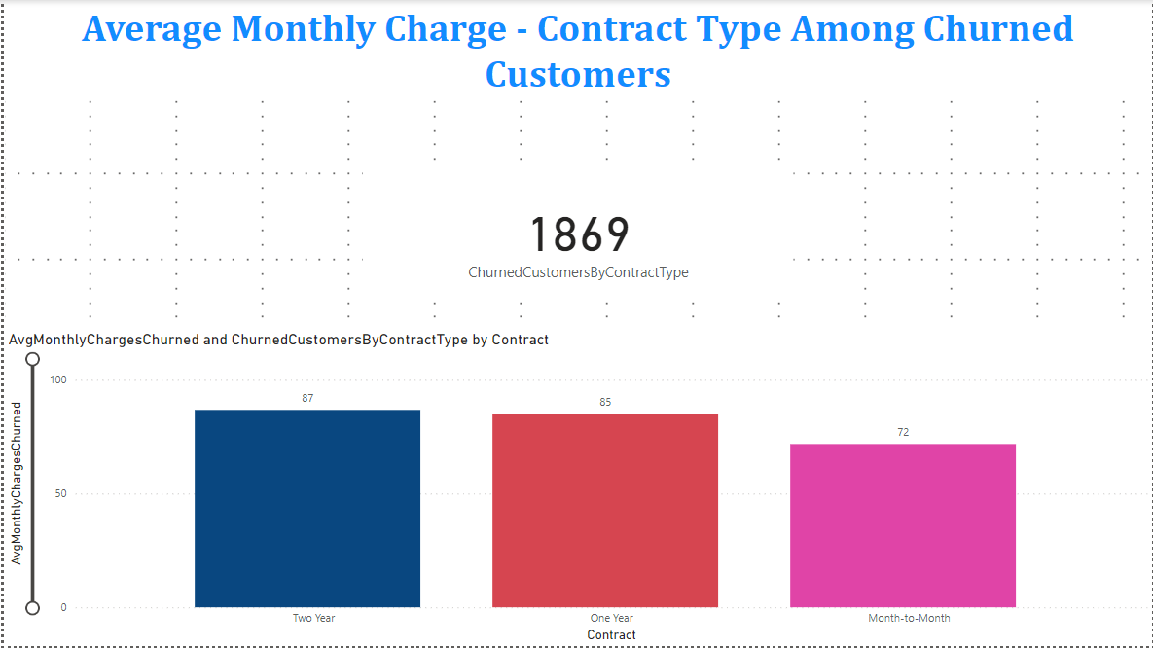
Power BI Visualization
Calculate Avg Monthly Charges – Contract Type Among – Churned Customers

Slide 55
Avg Monthly Charges – Contract Type – Churned Customers
For this visual avg. monthly charges churned measure created and churned customers by contract type measure used.
X-axis Contract
Y-axis Avg. Monthly Charges Churned
Churned Customer by Contract type used for clear visual.

Slide 56
SQL Visualization
Stored Procedure – Churn Rate

Slide 57
SQL Visualization – Stored Procedure – Churn Rate
This stored procedure calculates the churn rate and outputs it as a percentage.

Slide 58
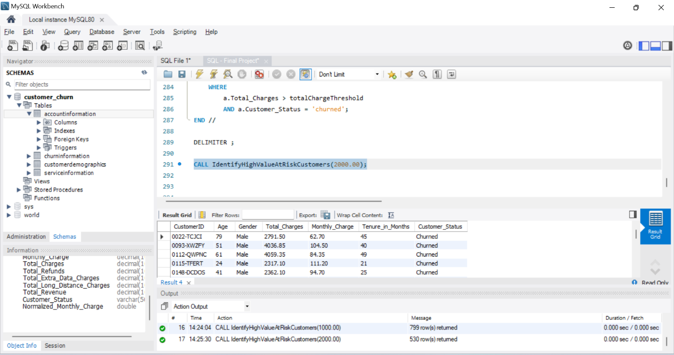
SQL Visualization
Stored Procedure – High-Value Customers Risk of Churn

Slide 59
SQL Visualization – Stored Procedure – High Value Customer Risk of Churn
This stored procedure identifies high-value customers who have churned and had total charges above a specified threshold.
Summary:
By using these queries and stored procedures, we can gain valuable insights into customer behaviour, identify at-risk customers, and develop strategies to reduce churn.

Slide 60
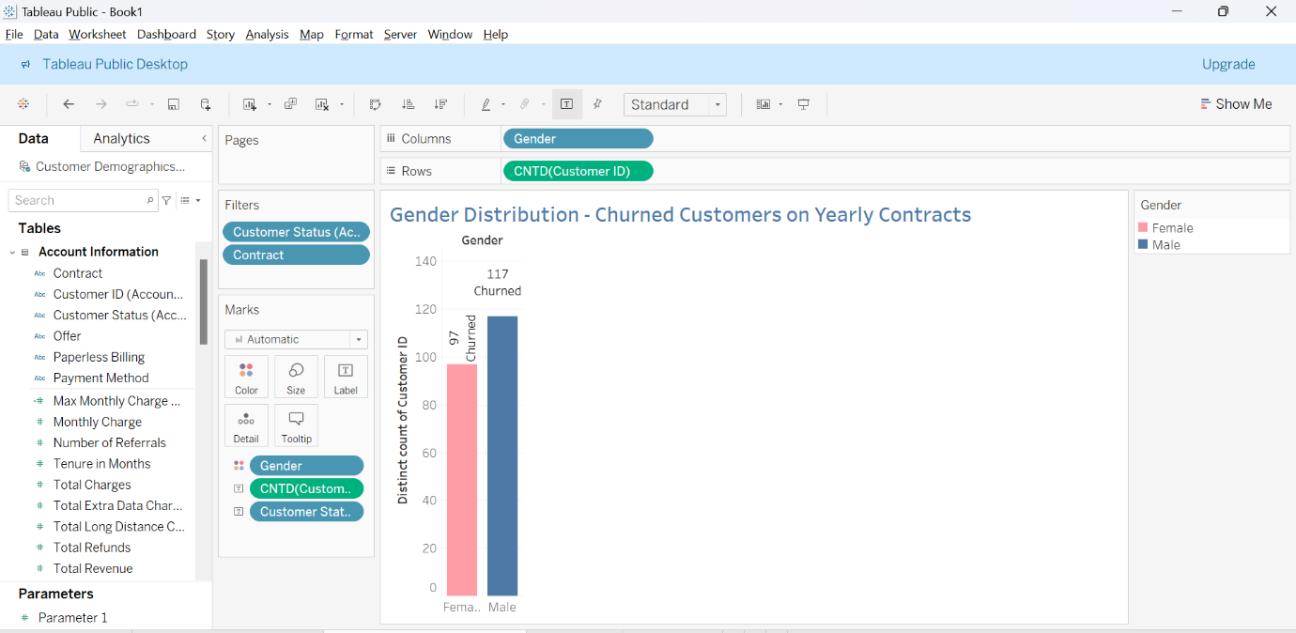
Tableau Visualization
Gender Distribution – Churned Customers on Yearly Contracts

Slide 61
Tableau Visualization – Gender Distribution – Churned Customers on Yearly Contracts
From this visual, we can understand the gender distribution among churned customers on yearly contracts.
Selected both 1 year and 2 year contract customers

Slide 62
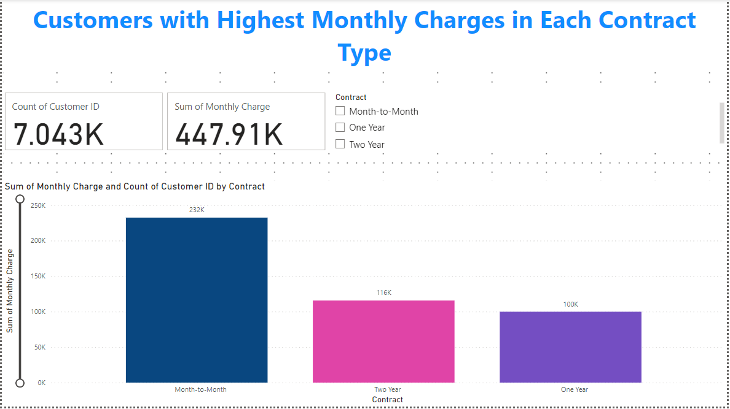
Power BI Visualization
Customers – High Monthly Charge – Contract Type

Slide 63
Power BI Visualization – Customers High Monthly Charge –Contract Type
X-axis Contract
Y-Monthly Charge
For more clarity, added a card visual – total customers, monthly charge. Slicer used for contract type.

Slide 64
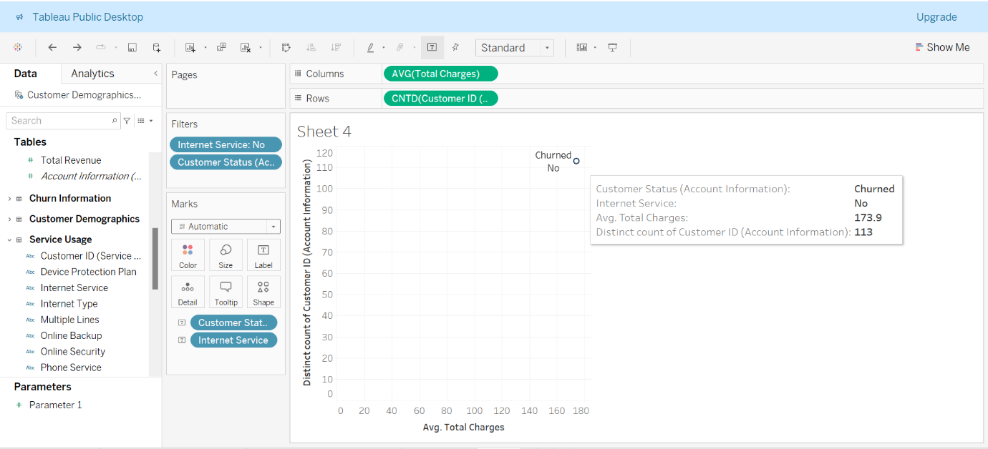
Tableau Visualization
Churned Customers – Not Using Online Service & Avg Total Charges

Slide 65
Tableau Visualization – Churned Customers – Not Using online Service & Avg Total Charges
From the visuals, among churned customers who do not have internet service and average. total charges.

Slide 66
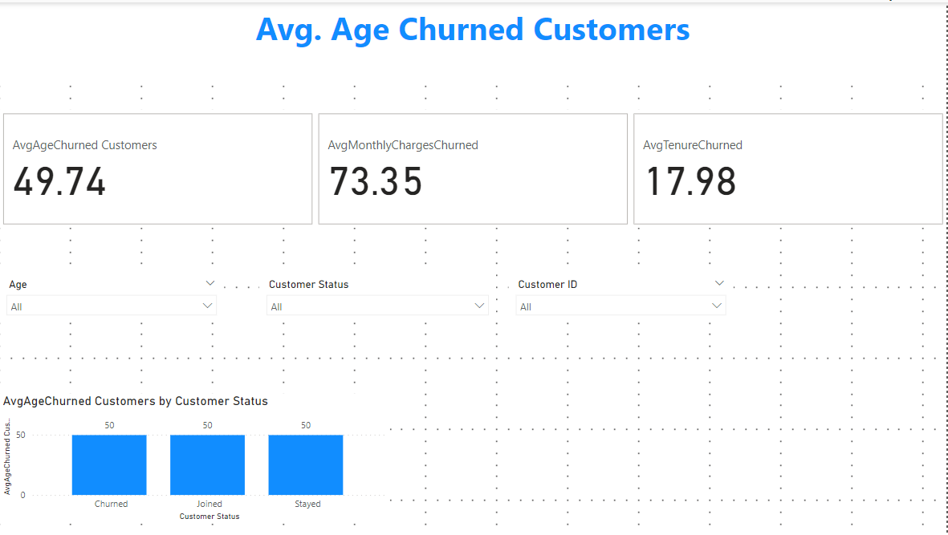
Power BI Visualizations
Avg Age -Churned Customers

Slide 67
Power BI Visualizations- Avg Age -Churned Customers
Bar visual created, avg. age of churned customer measure clearly shows the average. age of churned customers.

Slide 68
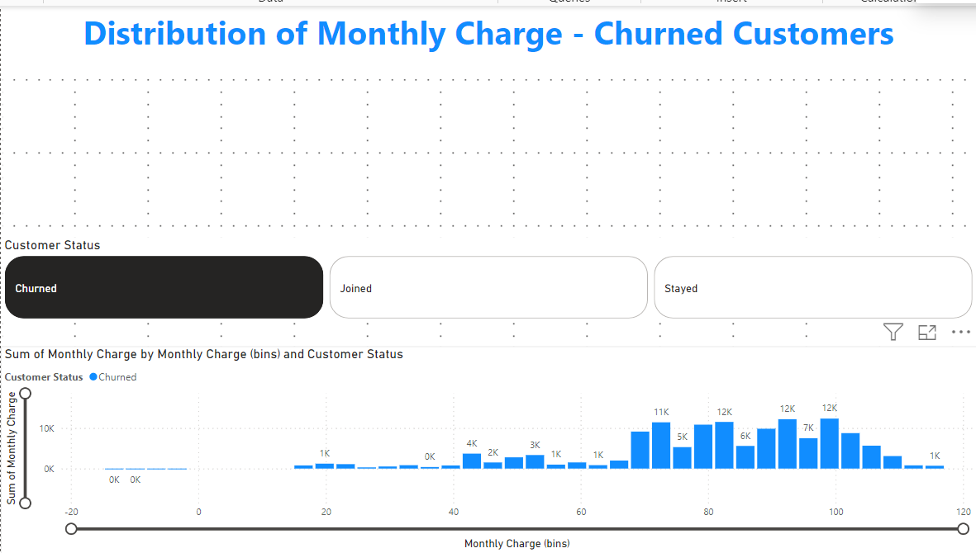
Power BI Visualizations
Distribution of Monthly Charges – Churned Customers

Slide 69
Power BI Visualizations- Monthly Charge Distribution -Churned Customers
For this visual, a monthly bin group was created, and customer status – was set as “churned’.

Slide 70
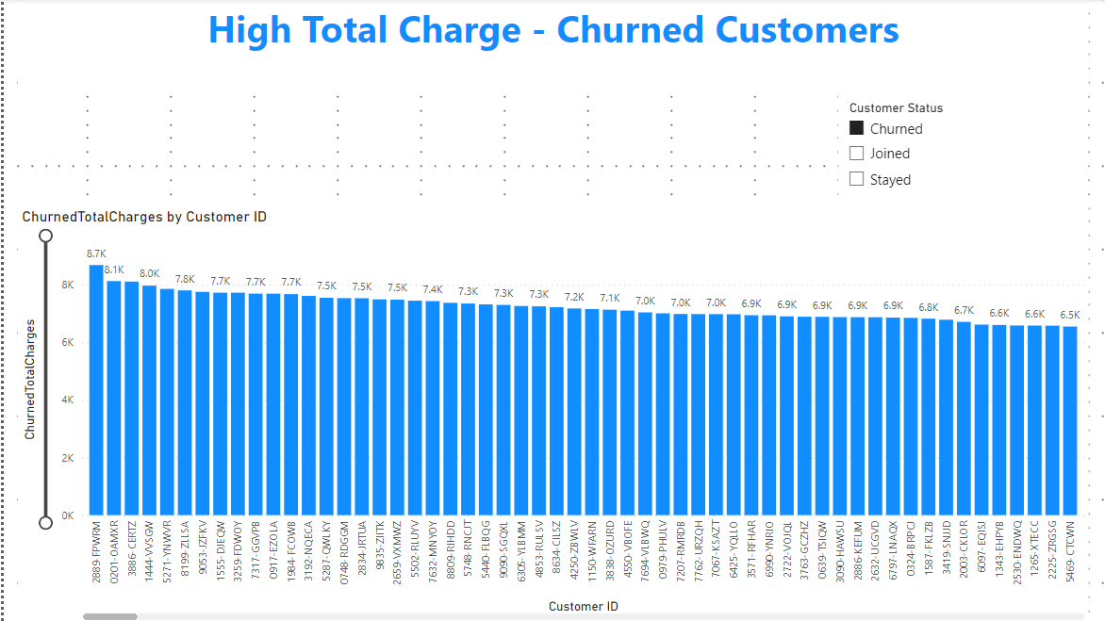
Power BI Visualizations
High Total Charges – Churned Customers

Slide 71
Power BI Visualizations- High Total Charge -Churned Customers
From this, we can understand the High Total Charge among churned customers.
Churned Total Charge measure used.
Customer status “churned”

Slide 72
Dashboards

Slide 73
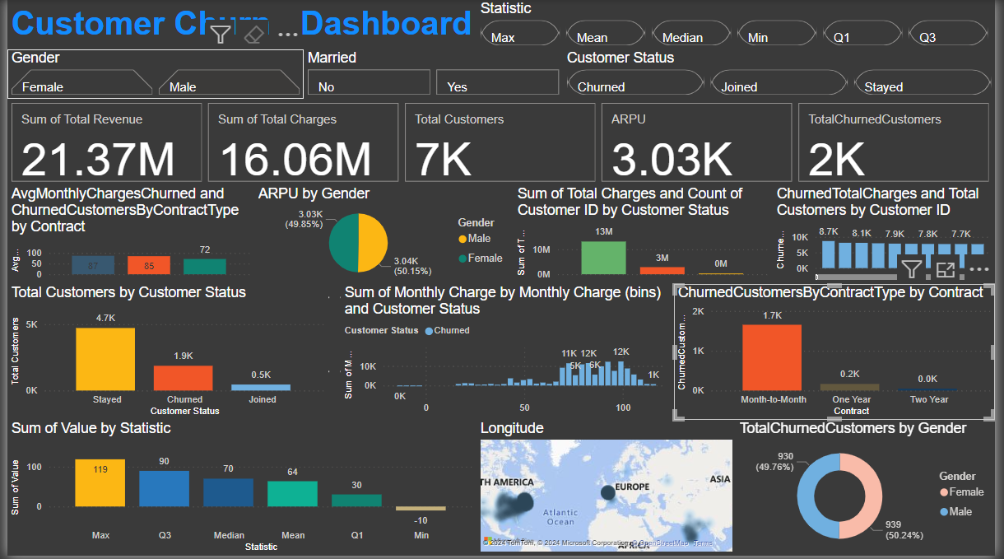
Power BI Dashboard

Slide 74
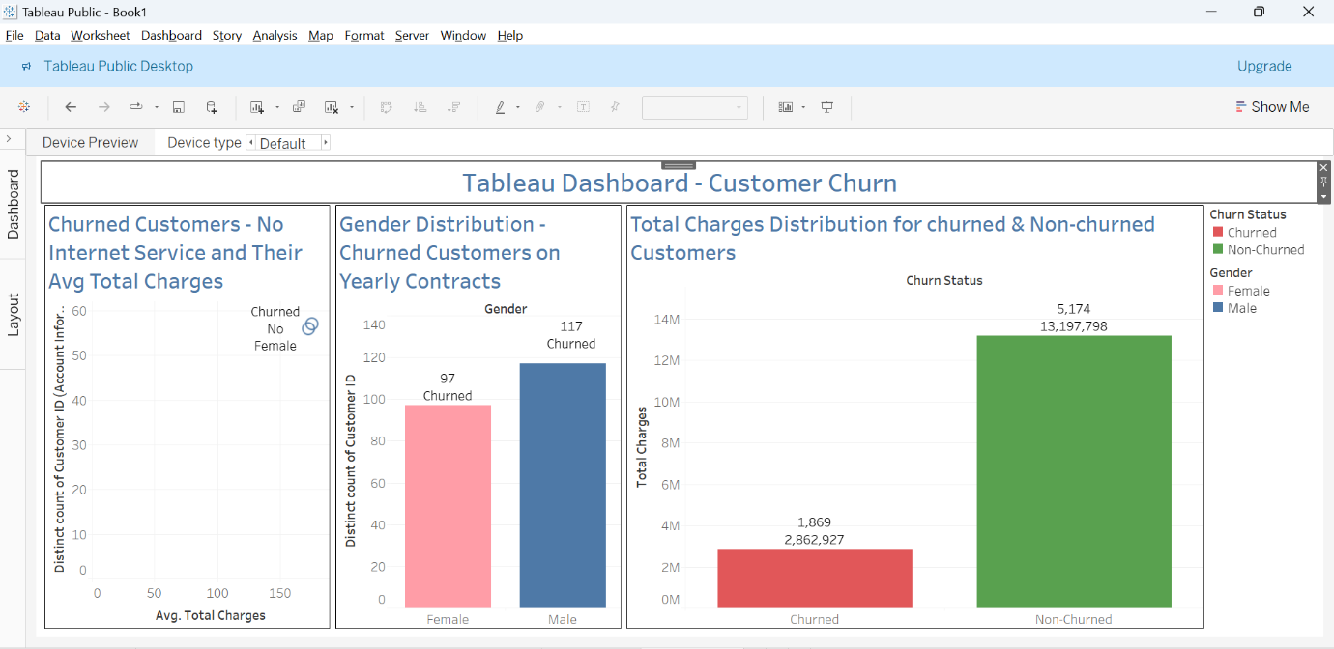
Tableau Dashboard

Slide 75
Power BI Dashboard - Explanation
Filters at the Top:
Gender: Allows filtering data by gender (Female, Male).
Married: Allows filtering by marital status (Yes, No).
Customer Status: Allows filtering by customer status (Churned, Joined, Stayed).
Key Metrics:
Sum of Total Revenue: Displays the total revenue generated.
Sum of Total Charges: Displays the total charges.
Total Customers: Displays the total number of customers.
ARPU (Average Revenue Per User): Displays the ARPU value.
Total Churned Customers: Displays the total number of customers who have churned.

Slide 76
Power BI Dashboard - Explanation
Charts and Graphs:
Avg Monthly Charges Churned and Churned Customers by Contract Type: A bar chart showing average monthly charges for churned customers categorized by contract type.
Total Customers by Customer Status: A bar chart displaying the number of customers by their status (Stayed, Churned, Joined).
ARPU by Gender: A pie chart showing ARPU values for Male and Female customers.
Sum of Total Charges and Count of Customer ID by Customer Status: A bar chart representing the sum of total charges and count of customer IDs, categorized by customer status.

Slide 77
Power BI Dashboard - Explanation
Charts and Graphs:
Sum of Monthly Charge by Monthly Charge (bins) and Customer Status: A histogram showing the distribution of monthly charges for churned customers.
Churned Total Charges and Total Customers by Customer ID: A bar chart showing total charges and the number of churned customers.
Churned Customers by Contract Type by Contract: A bar chart showing the number of churned customers by contract type.
Total Churned Customers by Gender: A pie chart representing the gender distribution of churned customers.

Slide 78
Power BI Dashboard - Explanation
Map:
Total Churned Customers by Geography: A map visual showing the geographical distribution of churned customers.
Other Visuals:
Sum of Value by Statistic: A bar chart displaying the sum of values by various statistics like Max, Q3, Median, Mean, Q1, Min.

Slide 79
Tableau Dashboard - Explanation
Churned Customers - No Internet Service and Their Average Total Charges:
This visualization shows the distribution of churned customers who do not use internet service and their average total charges.
Gender Distribution - Churned Customers on Yearly Contracts:
This bar chart shows the distribution of churned customers on yearly contracts by gender.
Total Charges Distribution for Churned and Non-Churned Customers:
This bar chart compares the total charges for churned and non-churned customers.

Slide 80
Tableau Dashboard - Explanation
General Insights from Both Dashboards
Churn Analysis by Contract Type:
In Power BI, the dashboard reveals that month-to-month contracts have the highest churn rate, which is visually represented in the "Churned Customers by Contract Type" bar chart.
Gender Distribution:
Both dashboards provide insights into the gender distribution of churned customers. In Tableau, a bar chart specifically highlights churned customers on yearly contracts by gender.

Slide 81
Tableau Dashboard - Explanation
General Insights from Both Dashboards
Revenue and Charges:
Both dashboards display metrics like total revenue, total charges, and ARPU. Power BI provides detailed breakdowns and distributions of these metrics.
Customer Status and Churn Rate:
Both dashboards give an overview of customer status, highlighting the number of churned, stayed, and joined customers. Power BI goes further by breaking down these metrics by various dimensions like contract type and monthly charges.

Slide 82
Tableau Dashboard - Explanation
Geographical Distribution:
The Power BI dashboard includes a map visual showing the geographical distribution of churned customers, which helps in understanding regional churn patterns.
These dashboards collectively provide a comprehensive view of customer churn, enabling the identification of key factors contributing to churn, demographic insights, and financial impacts. They can be used to inform strategic decisions to improve customer retention.

Slide 83
Phase - 4

Slide 84
Phase – 4 Business Recommendations
Phase-4: Recommendations Based on Business Use Cases
1. Customer Retention: Identify At-Risk Customers and Proactively Implement Retention Strategies
Objective: Minimize customer churn by identifying and addressing the needs of at-risk customers.
Recommendations:
Utilize Predictive Analytics: Use machine learning models to predict which customers are most likely to churn. Implement targeted retention strategies for these customers.
Personalized Communication: Reach out to at-risk customers with personalized offers and communication. Use data from the dashboards to tailor messages based on customer behaviour and preferences.
Loyalty Programs: Implement or enhance loyalty programs to reward long-term customers and provide incentives for staying.
Customer Feedback: Regularly collect and act on customer feedback to address issues before they lead to churn.

Slide 85
Phase – 4 Business Recommendations
2. Marketing Campaigns: Tailor Marketing Efforts Towards Customers Who Are More Likely to Churn
Objective: Increase the effectiveness of marketing campaigns by focusing on customers who are at risk of leaving.
Recommendations:
Segmented Campaigns: Use customer segmentation data to create targeted marketing campaigns. For instance, customers with high monthly charges but who are not using certain services can be targeted with campaigns promoting those services.
Special Offers: Develop special offers and discounts specifically aimed at at-risk customers to encourage them to stay.
Engagement Strategies: Implement engagement strategies that address the specific needs and pain points of at-risk customers.

Slide 86
Phase – 4 Business Recommendations
3. Service Improvement: Analyze Churn Patterns to Improve Service Offerings and Customer Support
Objective: Enhance service quality and customer support to reduce churn rates.
Recommendations:
Service Usage Analysis: Analyze the service usage patterns of churned customers to identify which services are underutilized or problematic. Improve these services based on customer feedback and usage data.
Support Enhancements: Invest in improving customer support channels, including quicker response times, better training for support staff, and more comprehensive self-service options.
Quality Assurance: Regularly monitor and improve service quality, ensuring that customers receive consistent and reliable service.

Slide 87
Phase – 4 Business Recommendations
4. Revenue Optimization: Reduce Churn Rates to Maintain a Steady Revenue Stream
Objective: Ensure stable and growing revenue by minimizing customer churn.
Recommendations:
Churn Impact Analysis: Regularly assess the financial impact of churn and prioritize efforts to retain high-value customers.
Revenue Forecasting: Use historical churn data to forecast revenue and identify potential risks. Adjust business strategies accordingly.
Bundling Services: Offer bundled services at a discounted rate to increase customer stickiness and reduce churn

Slide 88
Phase – 4 Business Recommendations
5. Customer Segmentation: Segment Customers Based on Churn Probability to Offer Personalized Experiences
Objective: Enhance customer experience by providing personalized services and offers.
Recommendations:
Behavioral Segmentation: Use data from the dashboards to segment customers based on their behavior, such as service usage, support interactions, and purchase history.
Personalized Offers: Develop personalized offers and recommendations for different customer segments. For instance, customers on monthly contracts might be offered discounts for switching to annual contracts.
Experience Enhancement: Use segmentation data to enhance the overall customer experience, addressing specific needs and preferences of different customer groups.

Slide 89
Phase – 4 Business Recommendations
Conclusion
By leveraging the insights from the dashboards and implementing these recommendations, the business can proactively address customer churn, tailor marketing efforts, improve service quality, optimize revenue, and provide personalized experiences to different customer segments. This holistic approach will help in achieving long-term customer retention and business growth.

Slide 90










Slide 91



THANK YOU!

